Slide 1

GROUP 5 RENEWABLE PRODUCT DEMAND FORECAST REPORT

Slide 2
FORECAST
Renewable Energy Consumption Forecast
Expected growth of 3.5% by 2030, indicating a rising interest and adoption of renewable energy, though moderate.

Slide 3
FORECAST
2. Renewable Energy Share
Currently stable but showing a slight decline of -0.25% in its market share. This may be due to competition or limited capacity expansion within renewable sectors.

Slide 4
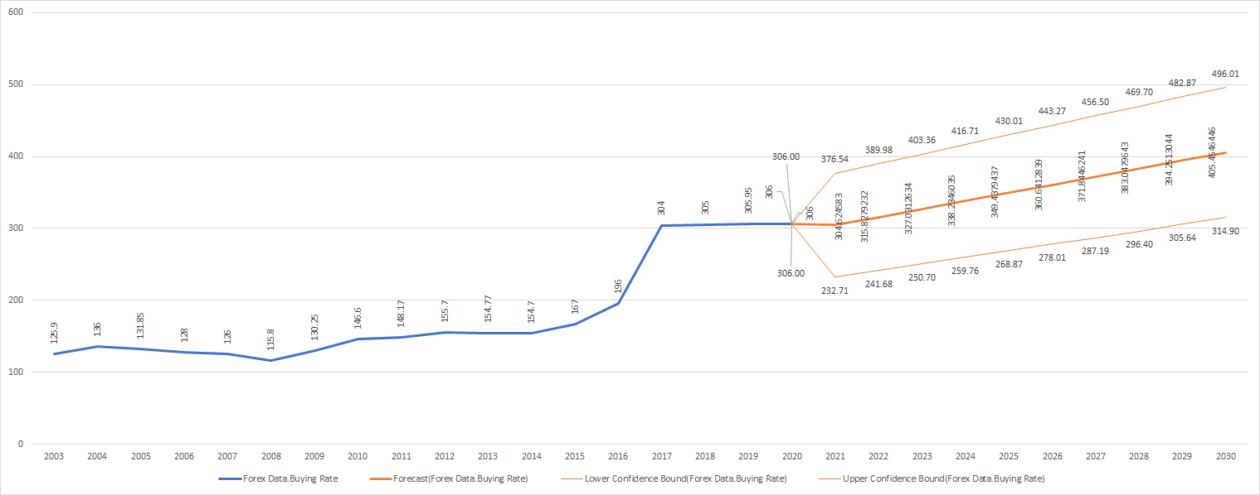
FORECAST
3. Exchange Rate Impact
Exchange rates have been on an upward trajectory since 2020, with an estimated annual increase of 3.2%, which affects the cost of imported renewable technology and impacts both product affordability and demand.

Slide 5
Findings and Insights
1. Renewable Energy Share
Financial investments in renewable energy show a significant spike most of the years signaling growing support and funding, potentially from government subsidies or private sector interest.

Slide 6
Findings and Insights
2. Renewable Energy Capacity (per Capita)
Observing a downward trend, indicating that while consumption grows, individual access or per-person infrastructure isn’t expanding proportionally. This could signal potential supply gaps in the future.

Slide 7
Findings and Insights
3. Inflation's Influence on Energy Consumption
Energy consumption seems steady despite inflation pressures, suggesting that energy needs are prioritized, with limited elasticity in demand relative to price changes.

Slide 8
Findings and Insights
4. Annual Energy Consumption
General upward trend, consistent with a global increase in energy demand. This suggests an overall growth in market size for renewable products.

Slide 9
Findings and Insights
5. Comparison of Exchange Rate and Renewable Energy Growth
Although exchange rates are increasing, renewable energy consumption is also growing gradually, albeit at a slower and steadier pace since 2015.
Rising exchange rates may lead to higher costs, potentially slowing growth in the long term if dependency on imports continues.

Slide 10

Recommendations
1. Expand Local Production
To counter rising exchange rates and their impact on product costs, encourage local production of renewable components (e.g., solar panels, batteries) to reduce import dependency and lower prices

Slide 11

Recommendations
2. Boost Renewable Capacity Initiatives
Address the decline in renewable capacity per capita by prioritizing infrastructure projects that increase accessibility, potentially through partnerships or subsidies to make renewable energy affordable and accessible.

Slide 12

Recommendations
3. Leverage Financial Flow Trends
With financial flows spiking, establish strategies to direct these funds effectively into sustainable projects that meet increasing demand and address per capita availability

Slide 13

Recommendations
4. Enhance Consumer Education and Subsidies
Given steady demand despite inflation, educational campaigns on long-term cost benefits of renewable energy can help sustain interest.
Additionally, government subsidies can offset high initial costs due to exchange rate rises

Slide 14

Recommendations
5. Monitor and Adapt to Exchange Rate Trends
As exchange rates are expected to continue rising, periodically assess the impact on renewable product pricing and adjust pricing strategies to avoid discouraging adoption

Slide 15
The demand for renewable energy products shows positive but gradual growth, driven by steady increases in energy consumption and financial flows, albeit impacted by challenges such as rising exchange rates and slightly declining renewable market share. Strategic focus on local production, financial investment alignment, and consumer incentives will be key to supporting sustainable growth in renewable energy demand.
Conclusion

Slide 16





GROUP 5 TEAM
IFEKA ODIRA HILLARY
LENU CONVENANT
ADEBAYO DEBORAH
DR. ISRAEL SAMUEL

